Slide 1



Final Project
View in Power BI
Last data refresh:
8/11/2024 11:01:01 PM UTC
Downloaded at:
8/11/2024 11:08:13 PM UTC

Slide 2
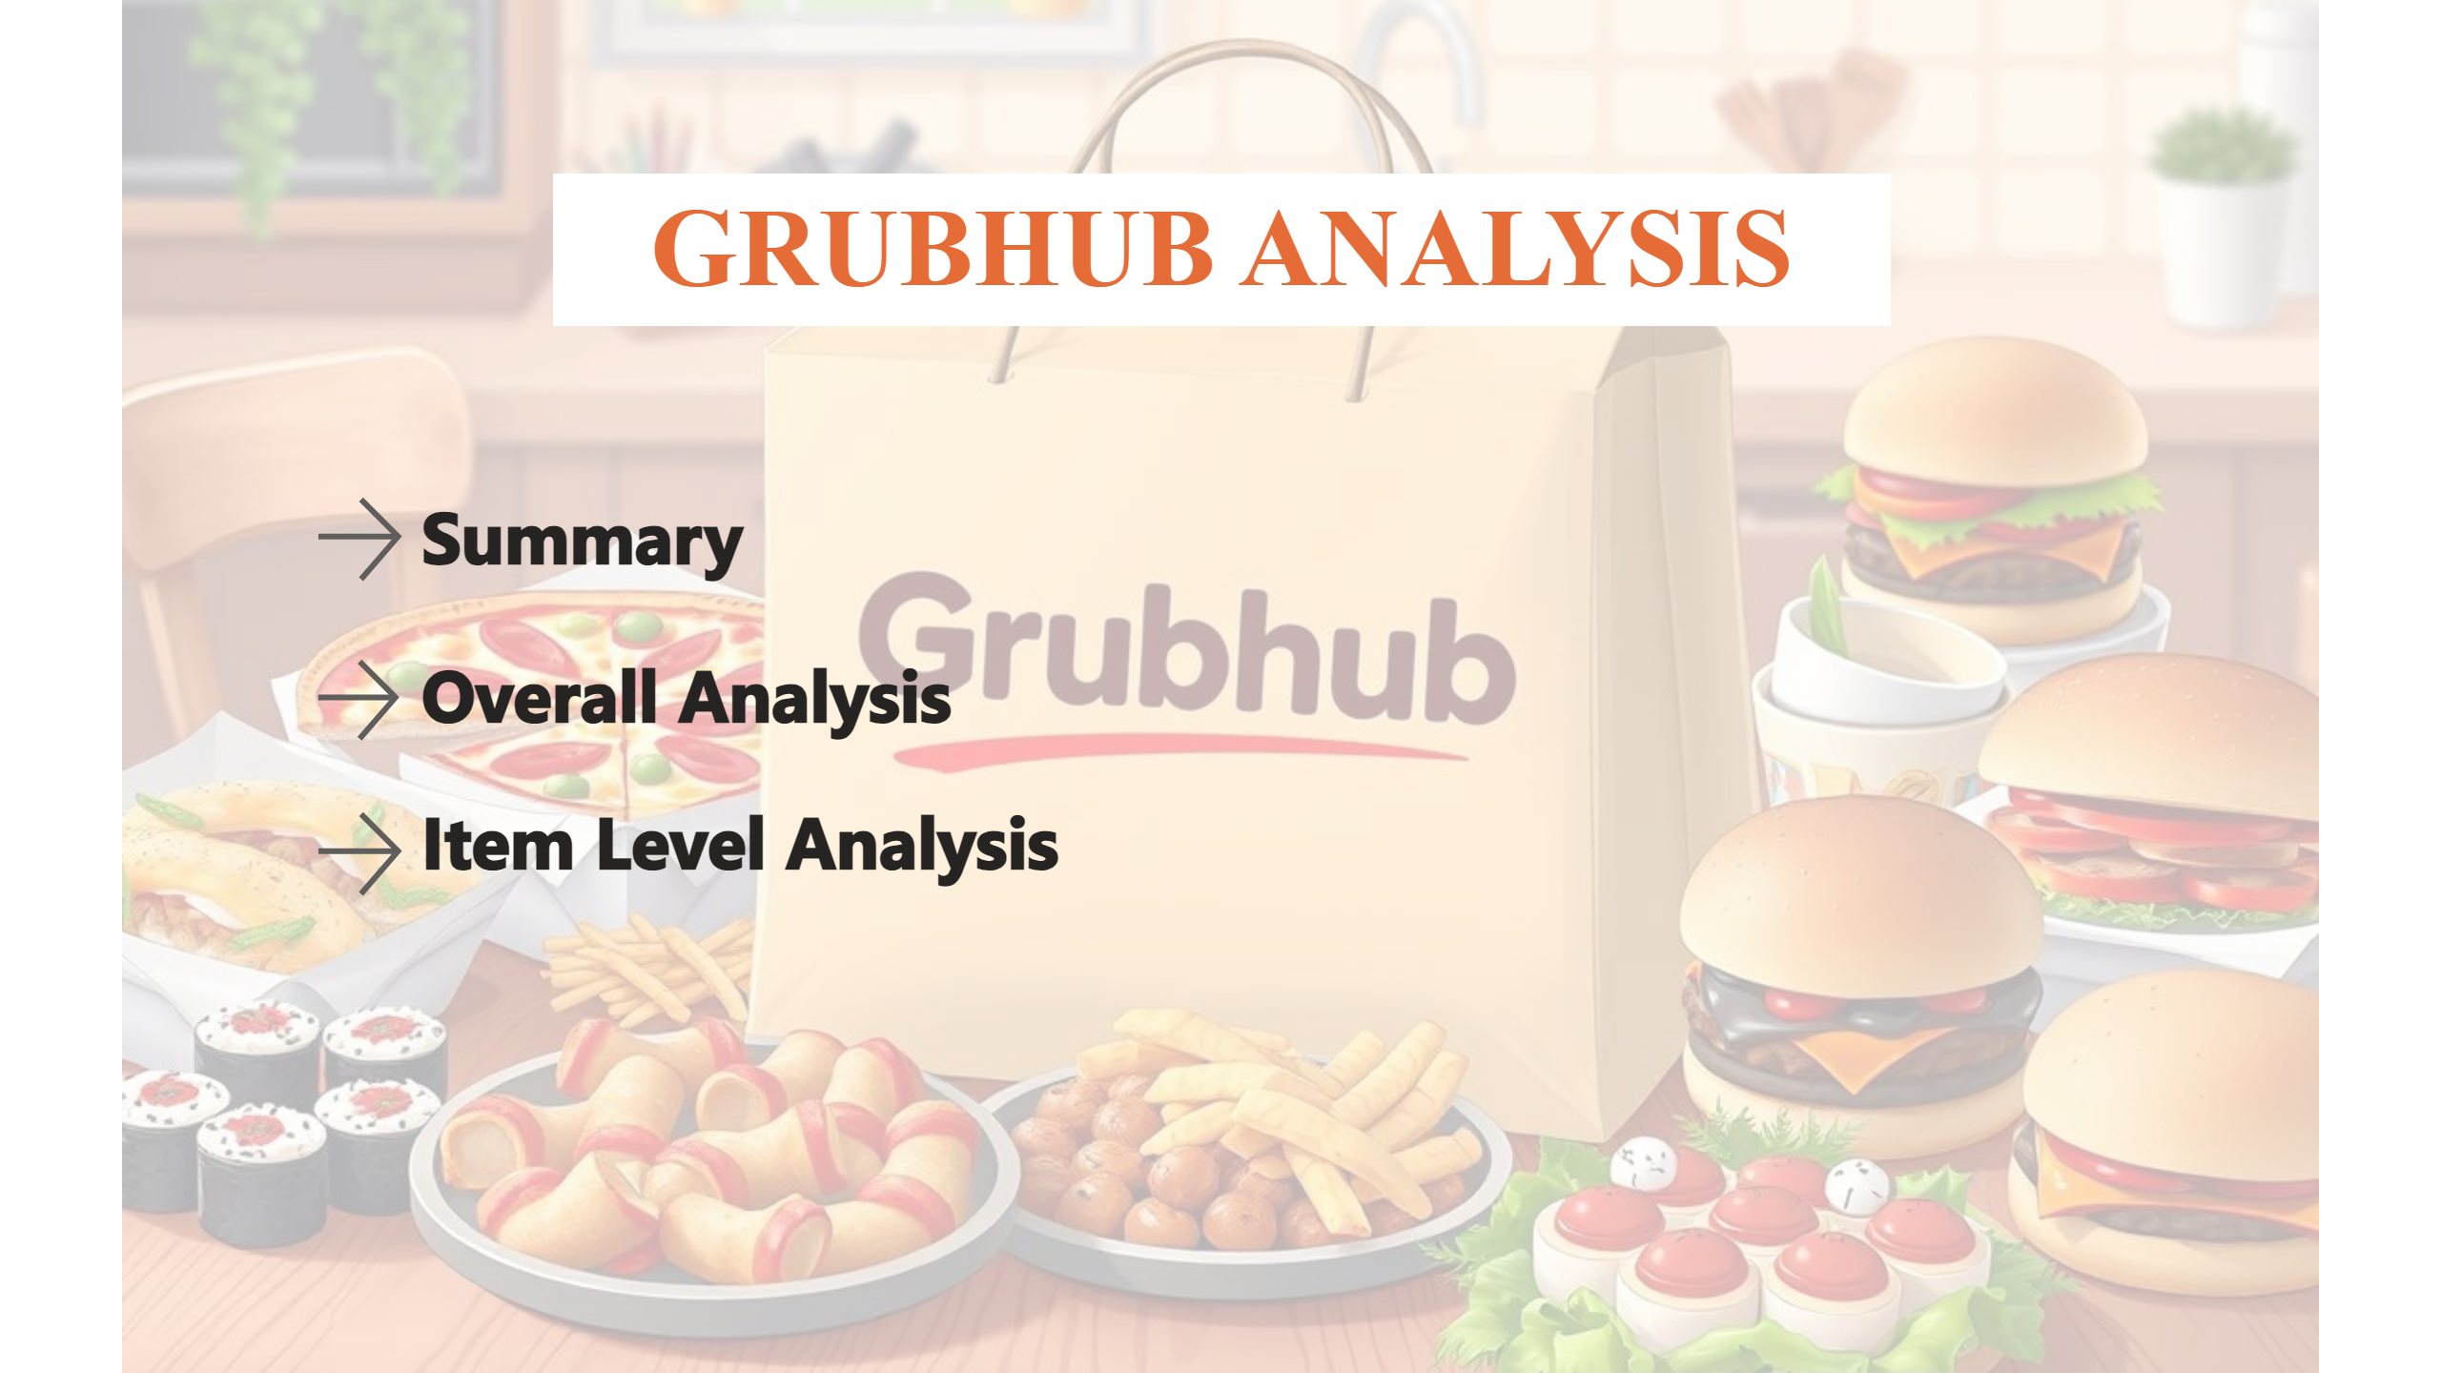
Grubhub Analysis
Notes:
textbox
No alt text provided
Summary
No alt text provided
textbox
No alt text provided
actionButton
No alt text provided
textbox
No alt text provided
actionButton
No alt text provided
textbox
No alt text provided

Slide 3
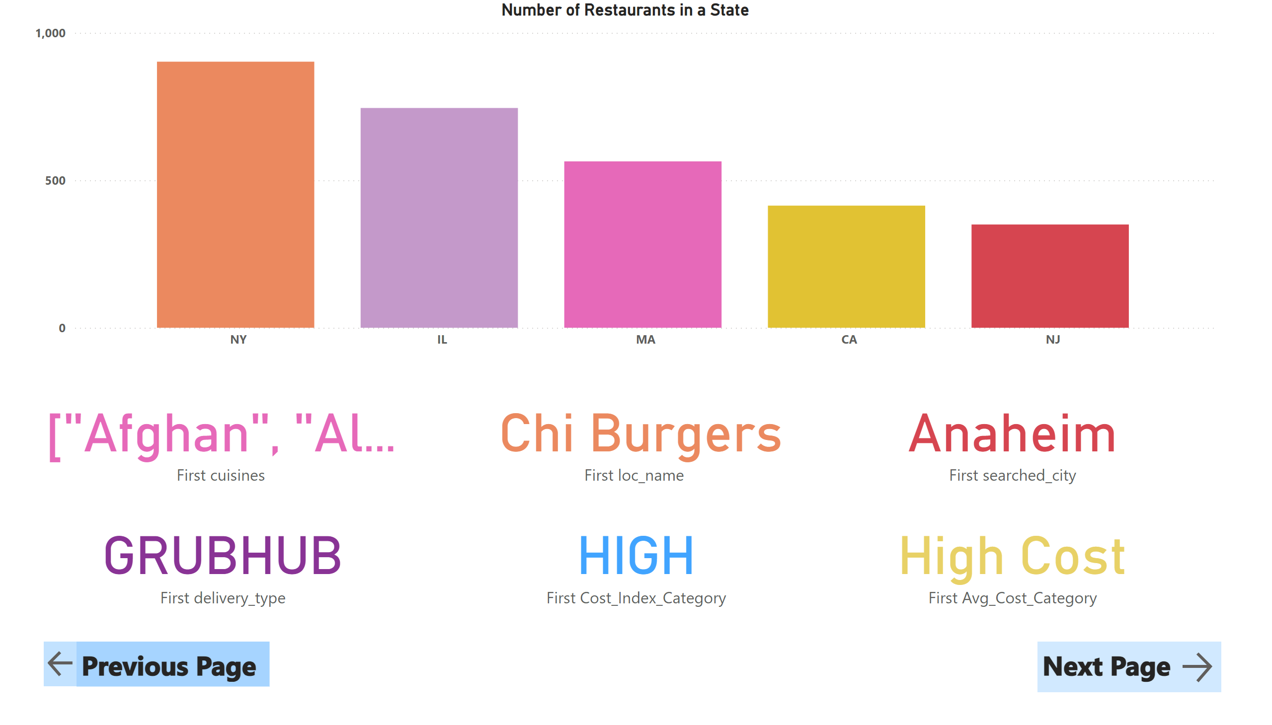
Summary
Notes:
Number of Restaurants in a State
No alt text provided
card
No alt text provided
card
No alt text provided
card
No alt text provided
card
No alt text provided
card
No alt text provided
card
No alt text provided
actionButton
No alt text provided
textbox
No alt text provided
actionButton
No alt text provided
textbox
No alt text provided

Slide 4
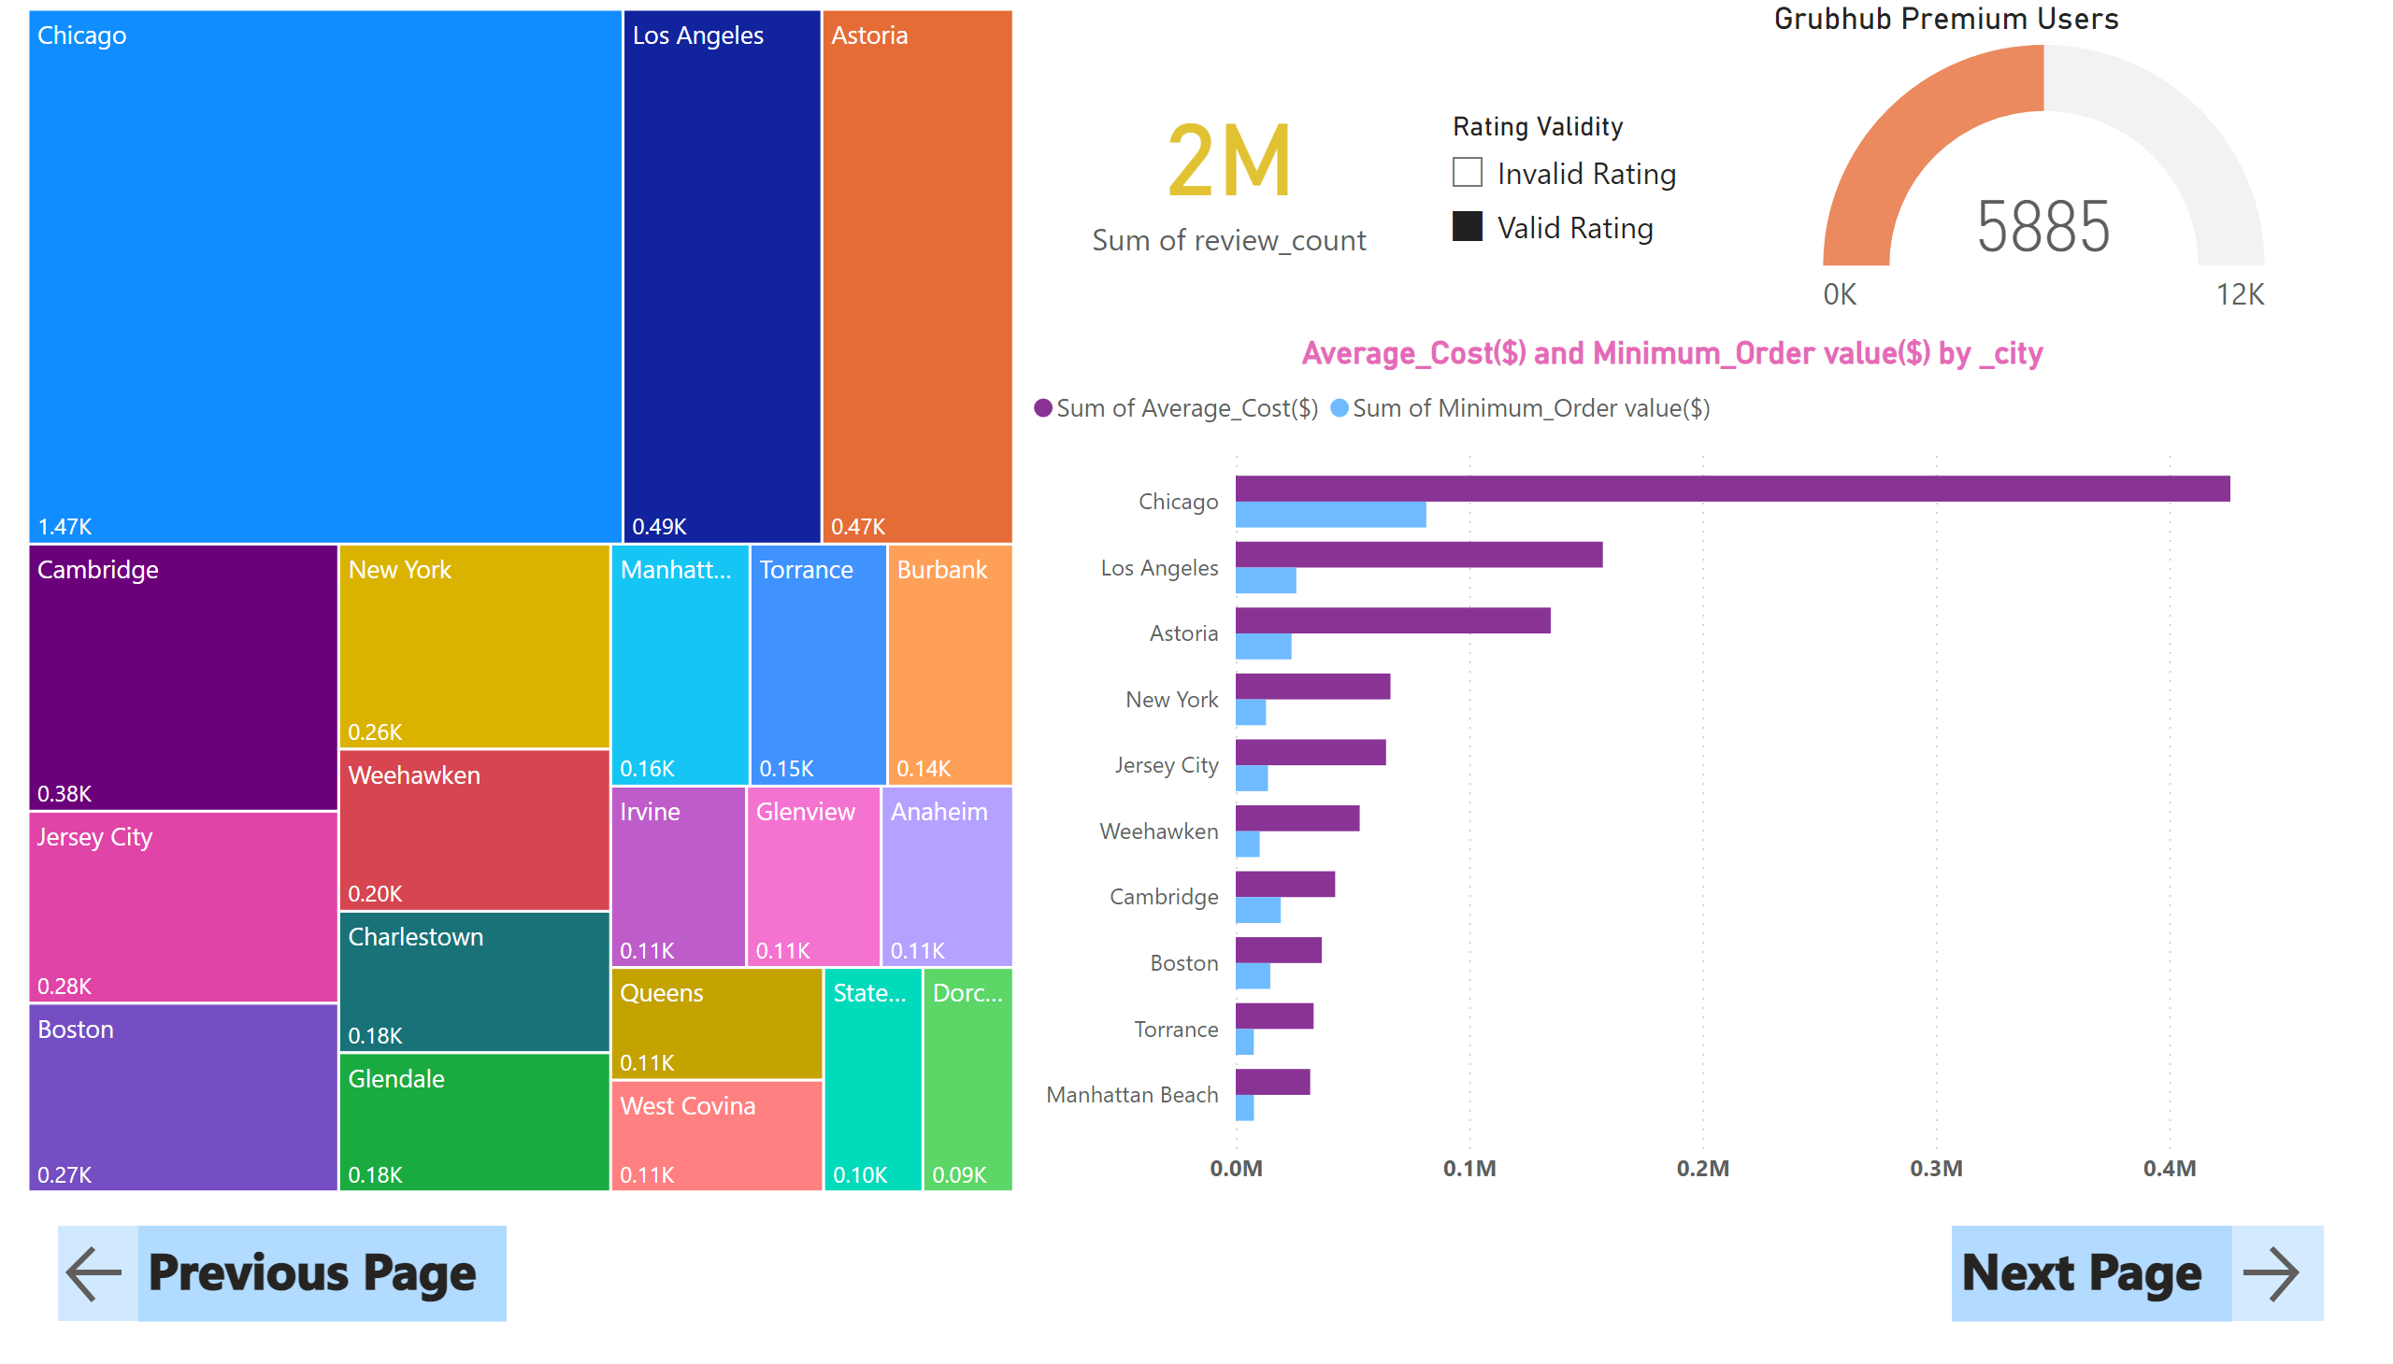
Overall Analysis
Notes:
treemap
No alt text provided
Average_Cost($) and Minimum_Order value($) by _city
No alt text provided
card
No alt text provided
gauge
No alt text provided
slicer
No alt text provided
actionButton
No alt text provided
textbox
No alt text provided
actionButton
No alt text provided
textbox
No alt text provided

Slide 5
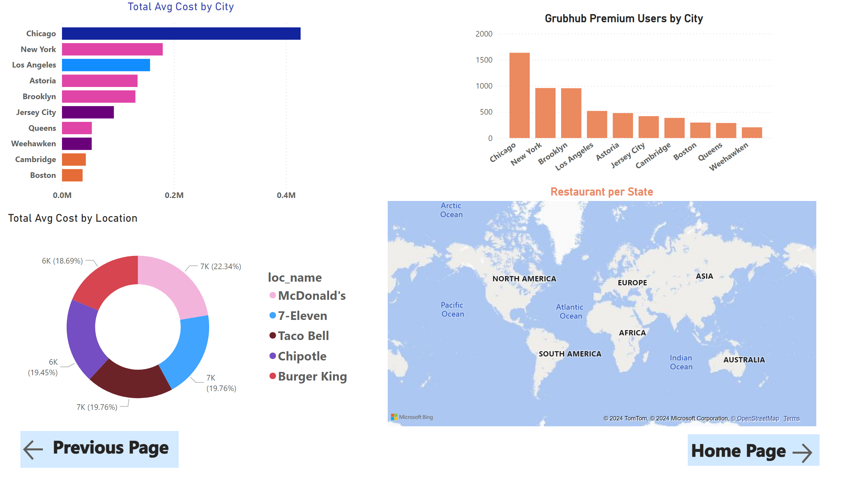
Item level Analysis
Notes:
Total Avg Cost by City
No alt text provided
Grubhub Premium Users by City
No alt text provided
Total Avg Cost by Location
No alt text provided
Restaurant per State
No alt text provided
actionButton
No alt text provided
textbox
No alt text provided
actionButton
No alt text provided
textbox
No alt text provided

